Slide 1
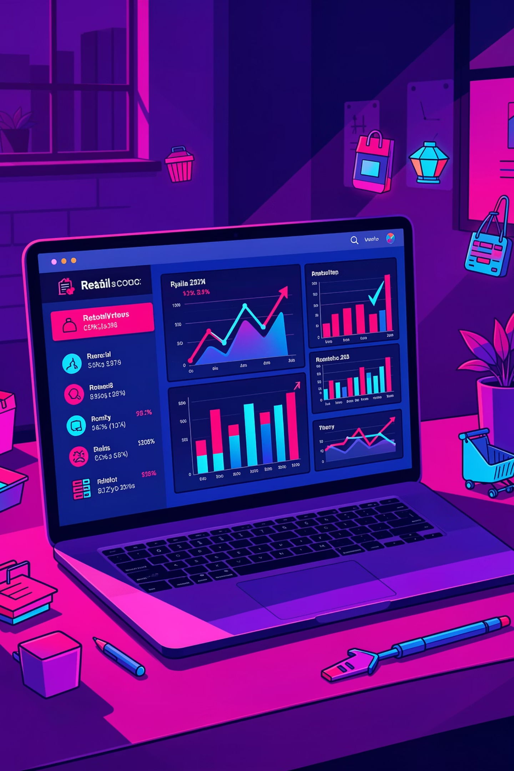
Customer Shopping Behavior Analysis
3,900 purchases • 18 features • Goal: uncover spending, segments, preferences, subscriptions

Slide 2
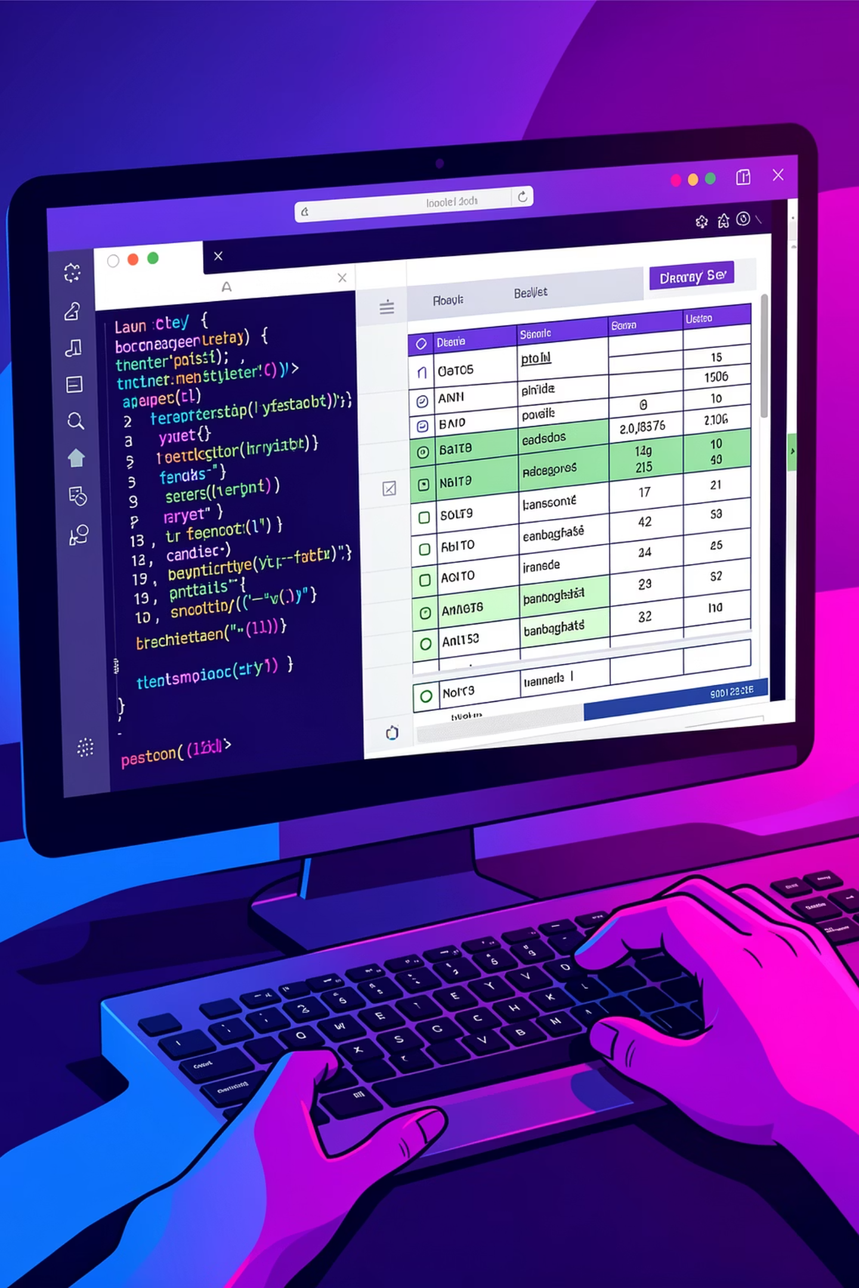
Dataset Summary
Scope
Key Features
Missing Data
Rows: 3,900 • Columns: 18
Demographics, purchase details, behavior flags
37 missing values in Review Rating

Slide 3
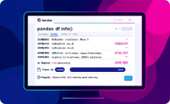


Data Preparation in Python
Explore
Impute
Standardize
df.info() and .describe()
Median rating by product category
Rename columns to snake_case

Slide 4
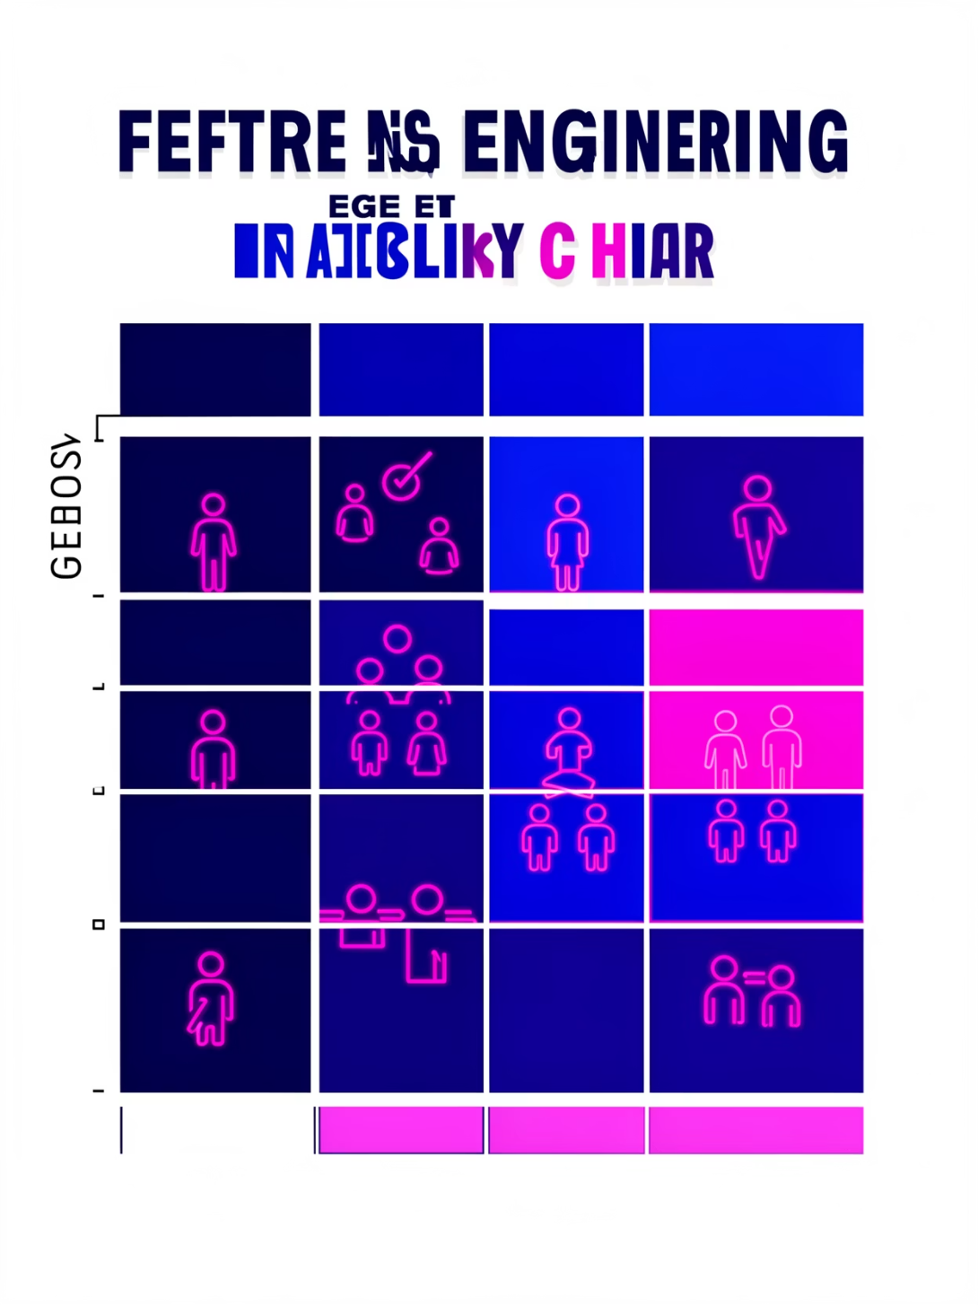

Feature Engineering
Age Groups
Frequency
Redundancy Check
Binned customer ages → age_group
purchase_frequency_days from timestamps
Dropped promo_code_used (redundant with discount_applied)

Slide 5

Database Integration
Loaded cleaned DataFrame into PostgreSQL for SQL analysis

Slide 6
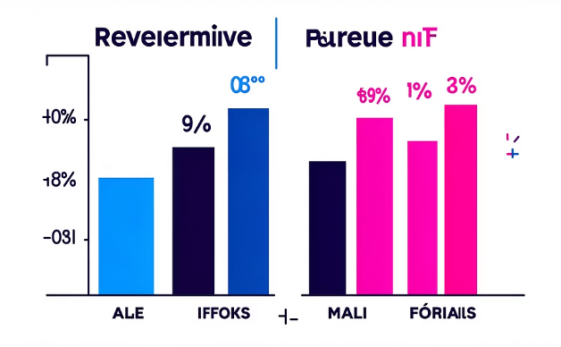
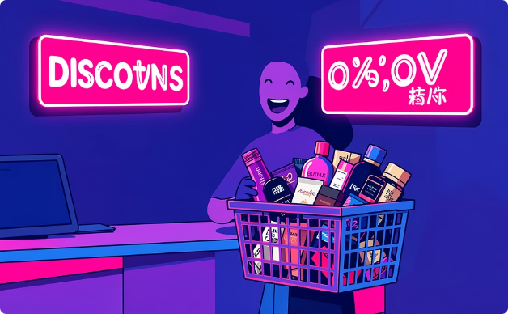
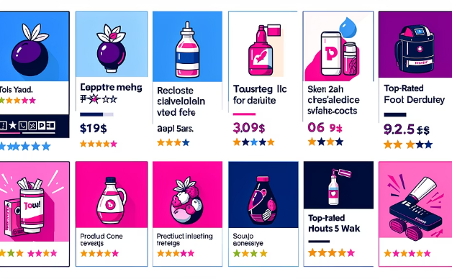
SQL — Key Business Analyses
Revenue by Gender
High-Spending Discount Users
Top Products by Rating
Compare total revenue: male vs female
Discount used but spend above average
Top 5 products with highest average ratings

Slide 7
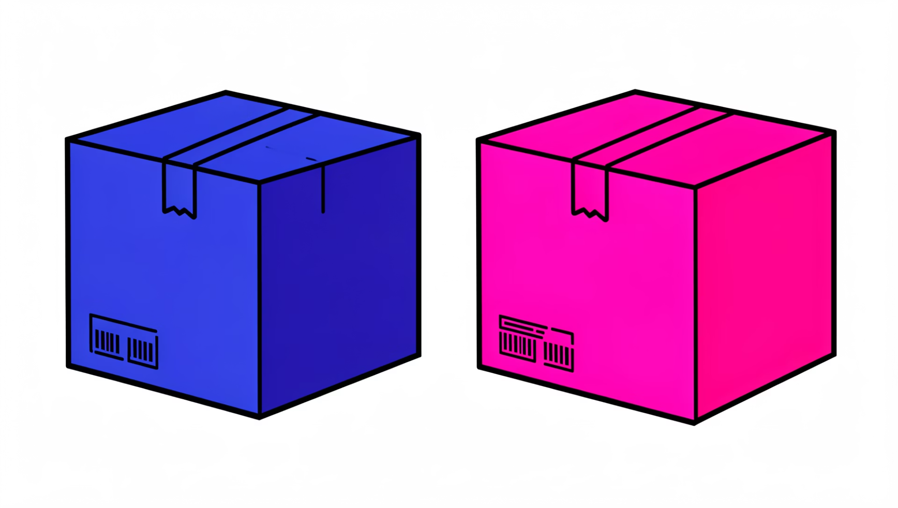
Shipping & Subscription Insights
Shipping Type
Compare avg purchase amount: Standard vs Express
Subscribers
Compare avg spend & total revenue: subscribers vs non-subscribers
Repeat Buyers
Customers with >5 purchases → likelihood to subscribe

Slide 8
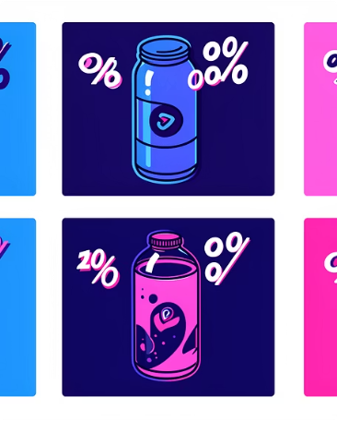
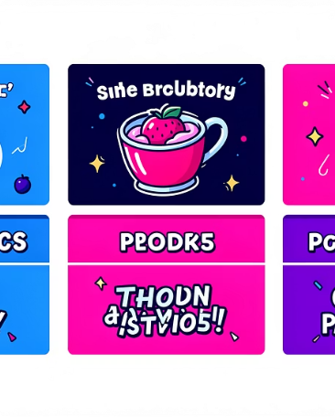
Product & Discount Analysis
Discount-Dependent Products
Top Products per Category
5 products with highest % of discounted purchases
Most purchased items within each category

Slide 9
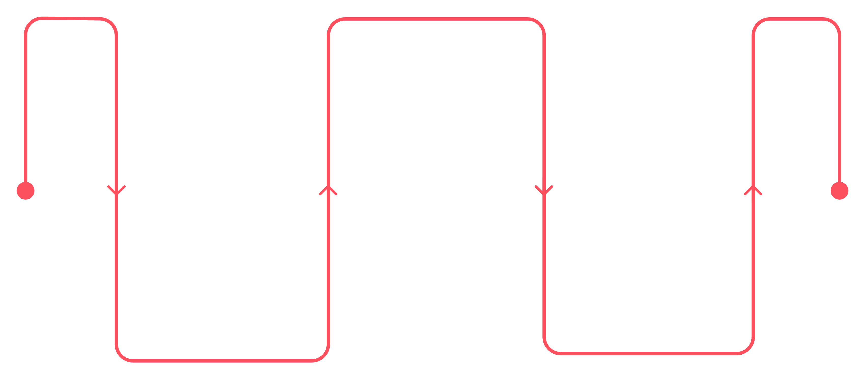
Returning
2-4 purchases • medium subscription likelihood
New
Loyal
0-1 purchases • low subscription likelihood
5+ purchases • high subscription likelihood
Customer segmentation: New, Returning, Loyal — guides loyalty and subscription strategies

Slide 10
Business Recommendations
Boost Subscriptions
Loyalty Programs
Review Discounts
Product Positioning
Promote exclusive subscriber benefits
Reward repeat buyers to shift to Loyal segment
Balance sales uplift with margin control
Feature top-rated & best-selling items in campaigns
Targeted Marketing
Focus on high-revenue age groups & express-shipping users

